Slide 1



BLack MEsa H.R.M.S
< Developed by Huseyn Ahmedov />
All rights reserved , Black Mesa Research Facility © 2022

Slide 2
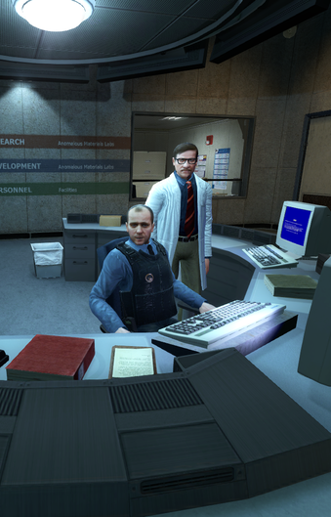

// Idea
Human Resource Management Studio
Black Mesa Research Facility

Slide 3
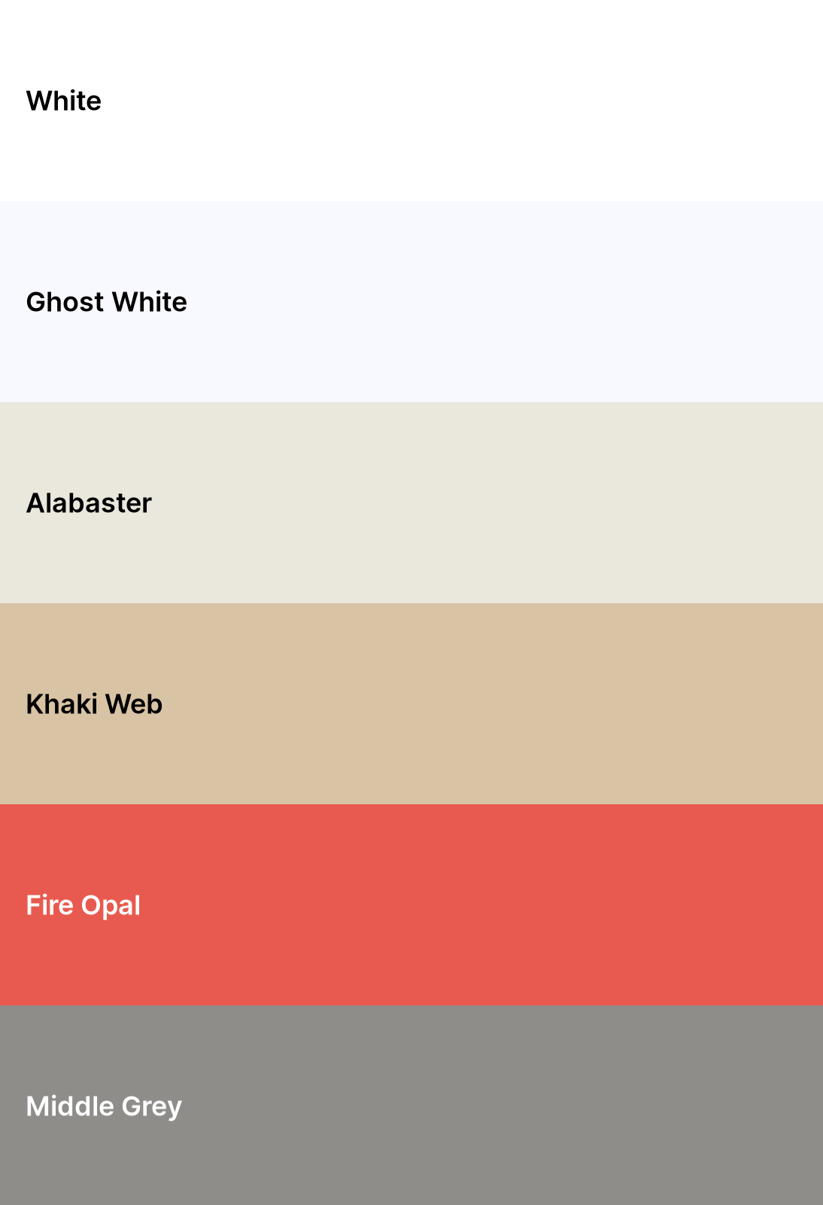



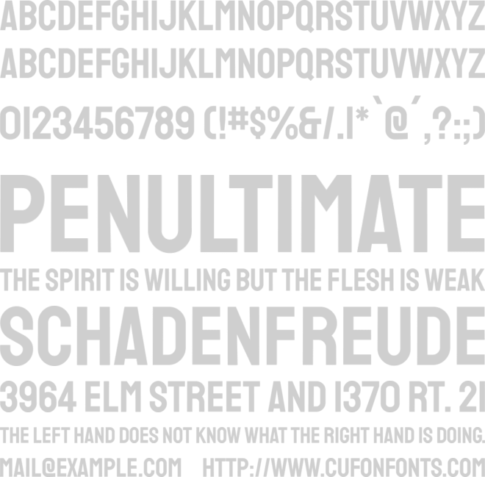

// Design
Poppins
Abril fatface
Open Sans
Staatliches

Slide 4







<h2> Tools </h2>
<h2> Assets </h2>

Slide 5
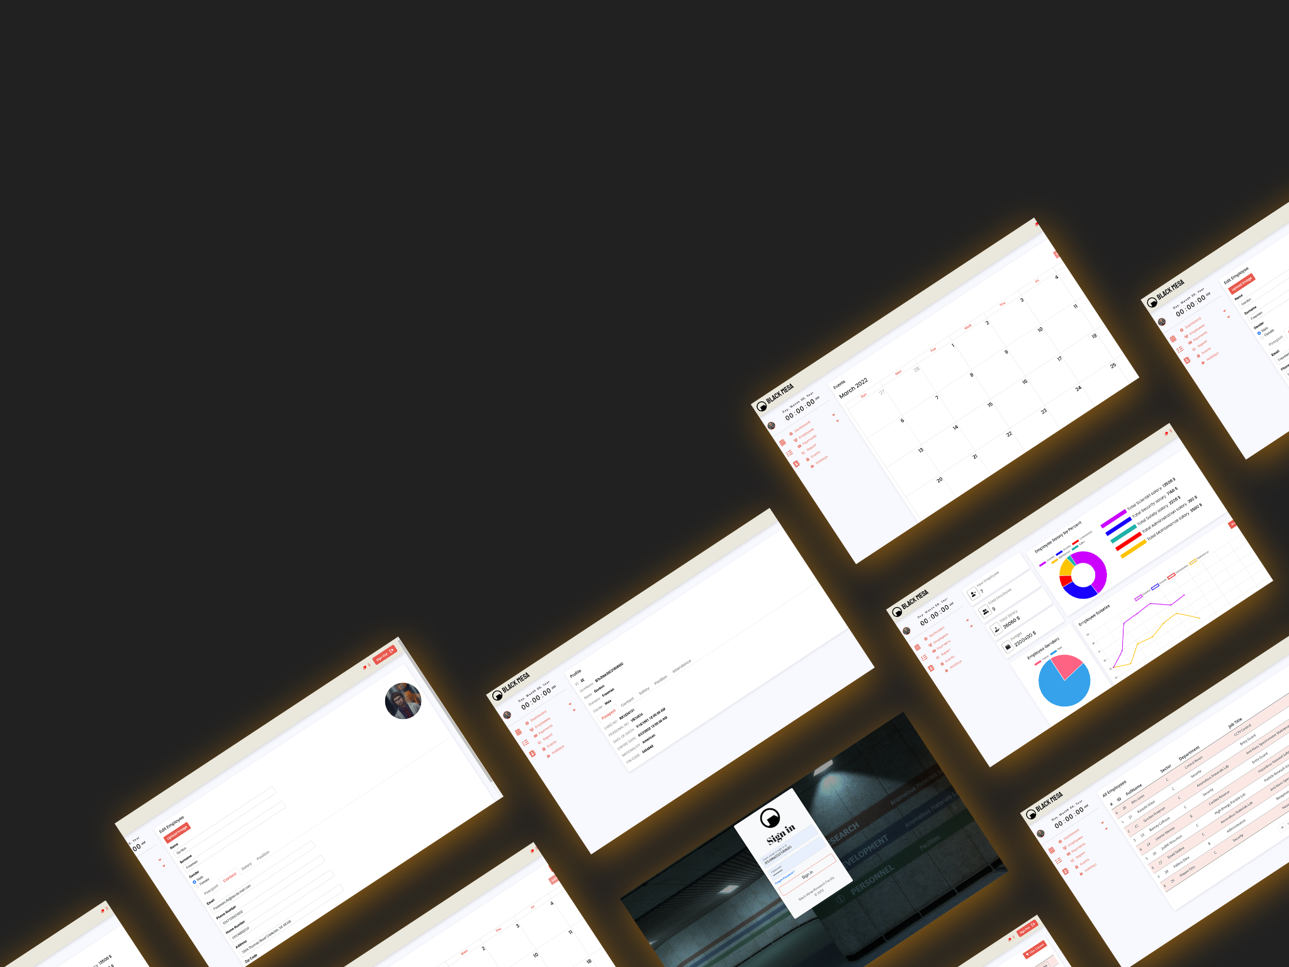
// Questions ?

